Slide 1
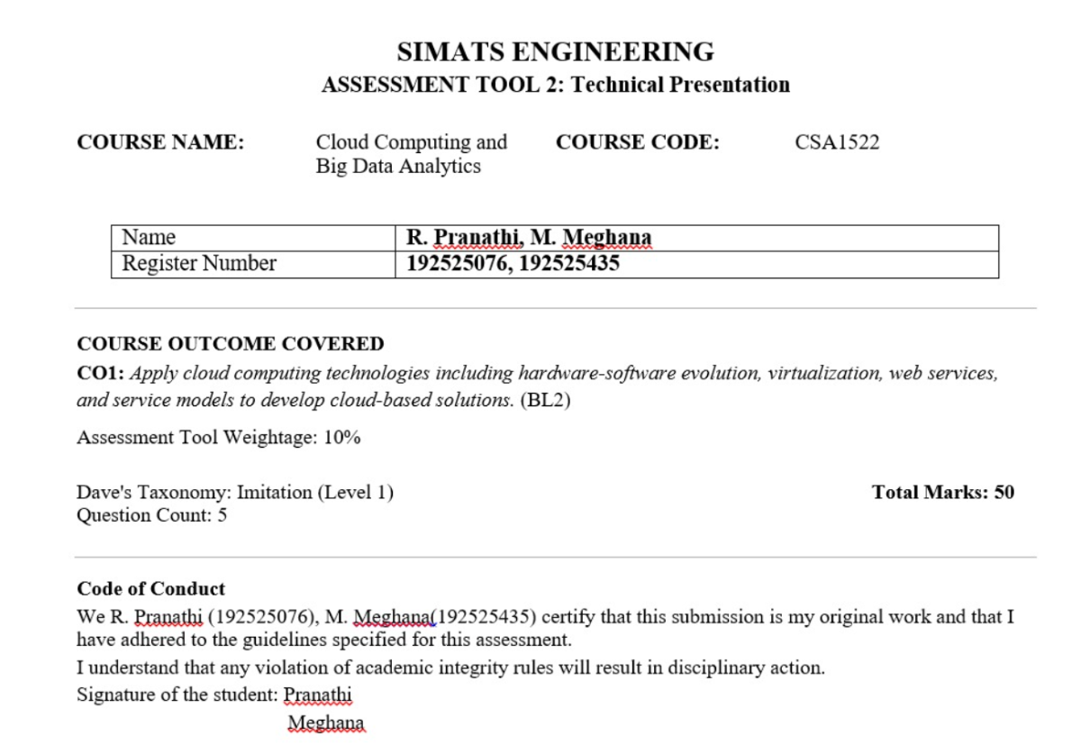

Slide 2
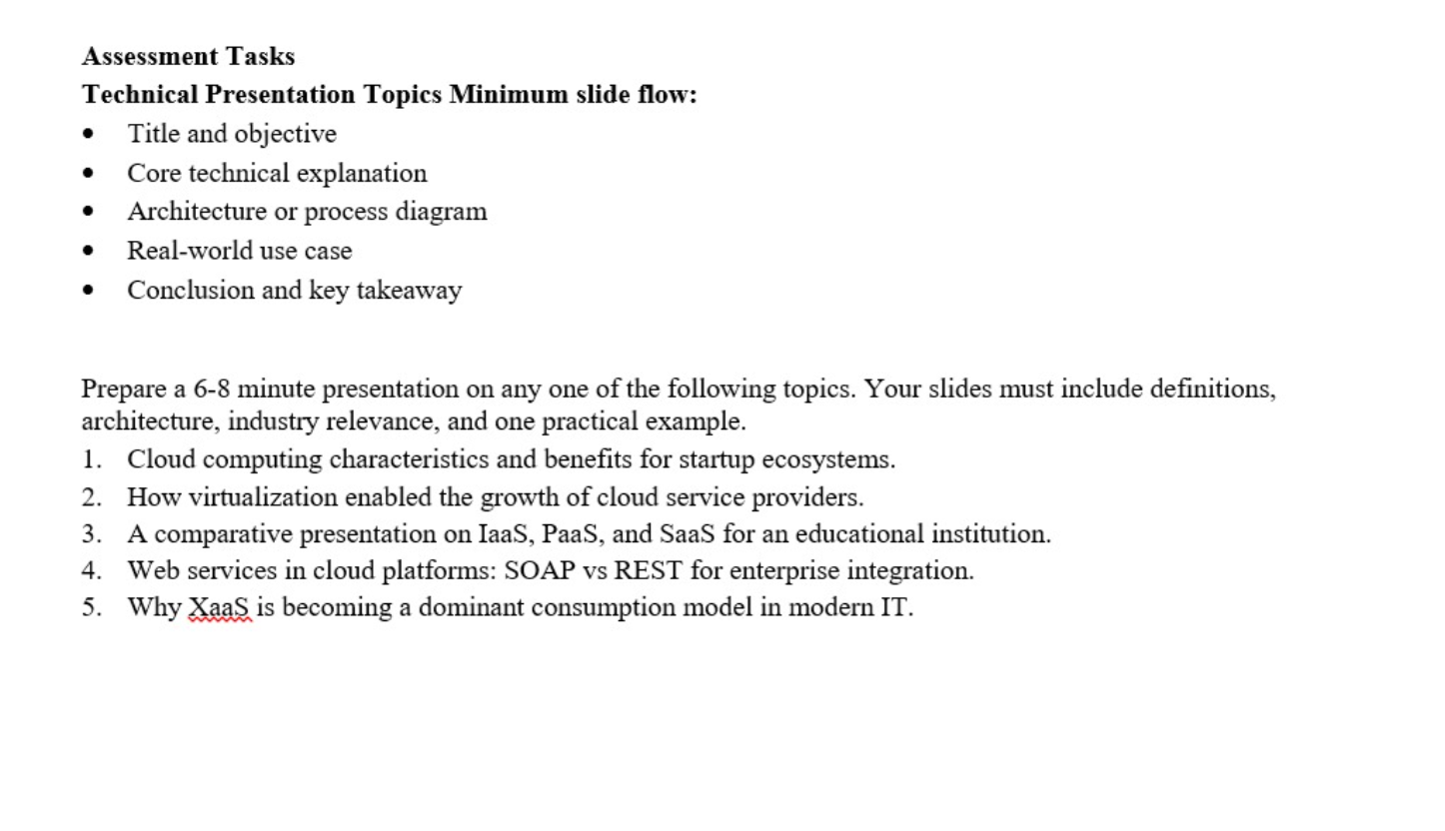

Slide 3
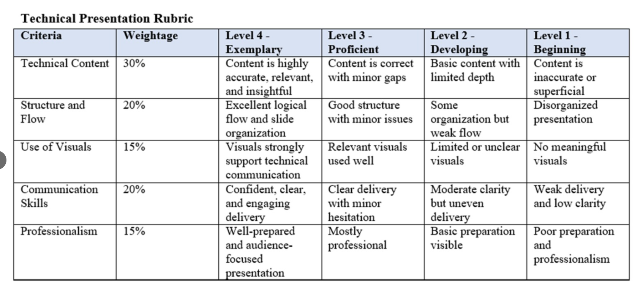

Slide 4

CO1-AT2-TECHNICAL PRESENTATION
CSA1522 : Cloud Computing for Bigdata Analytics
PRESENTED BY :
R. Pranathi(192525076)
M. Meghana(192525435)

Slide 5


How virtualization enabled the growth of cloud service providers

Slide 6
What is Virtualization?
Definition
Virtualization is the creation of multiple virtual machines (VMs) on a
single physical server.
Each VM has its own operating system and applications.
It allows efficient use of hardware resources.
Key Components:
Physical Server
Hypervisor
Virtual Machines (VMs)

Slide 7
What is Cloud Computing?
Cloud Computing
Delivers computing services over the internet.
Users can access servers, storage, databases, and software on demand.
Cloud Service Models:
IaaS
PaaS
SaaS

Slide 8
How Virtualization Works
Working Process
Physical server is installed.
Hypervisor is installed.
Hypervisor creates multiple VMs.
Each VM runs independently.
Users access services through the cloud.

Slide 9
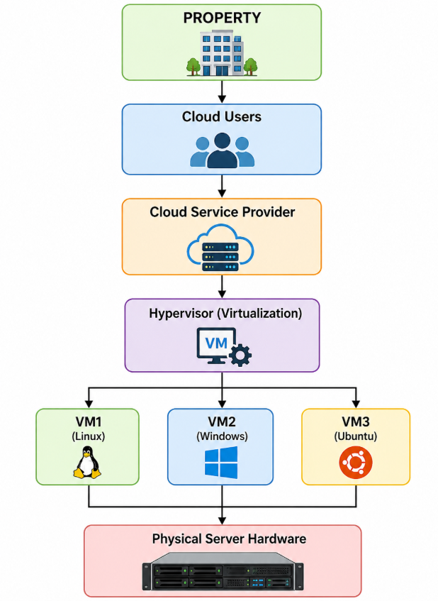
Architecture Diagram

Slide 10
Benefits of Virtualization
Advantages
Better resource utilization
Reduced hardware cost
Easy scalability
Faster deployment
High availability
Disaster recovery
Lower power consumption
Improved security through VM isolation

Slide 11
Real-World Use Case
Amazon Web Services (AWS EC2)
Uses virtualization to create virtual servers.
Customers launch VMs within minutes.
Pay only for used resources.
Supports businesses worldwide.
Other Providers:
Microsoft Azure
Google Cloud Platform
IBM Cloud

Slide 12
Why Virtualization Helped
Cloud Providers Grow
Reduced infrastructure costs.
Increased server utilization.
Enabled on-demand resource allocation.
Supported millions of users simultaneously.
Improved reliability and scalability.
Made cloud services affordable.

Slide 13
Conclusion
Virtualization is the foundation of cloud computing.
It allows multiple virtual machines to share one physical server.
Cloud providers can deliver scalable, flexible, and cost-effective services.
Modern cloud platforms rely heavily on virtualization technology.

Slide 14
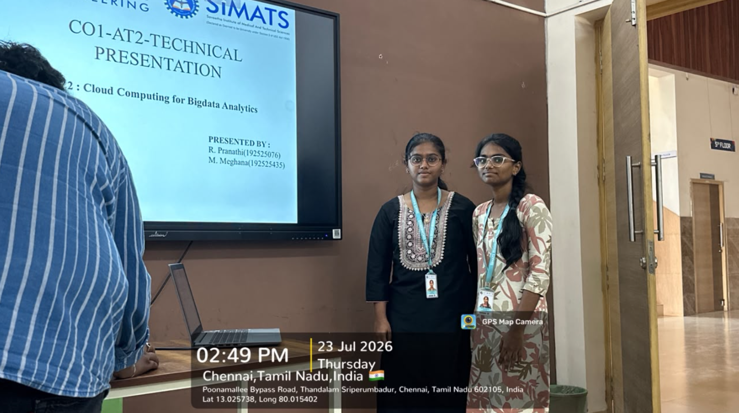

Slide 15
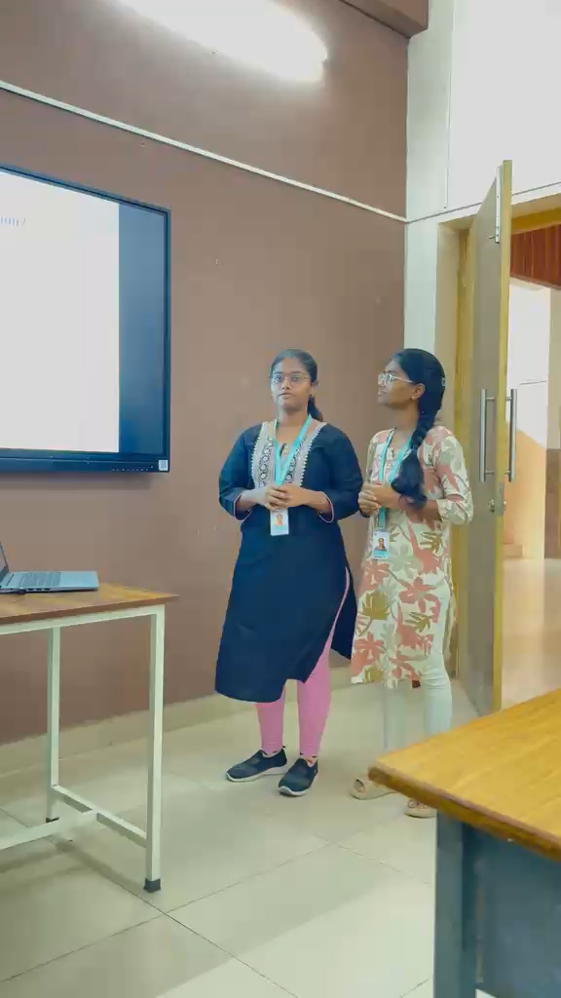

Slide 16


